Slide 1

Data
17 November 2023
Ahmad Agus Widodo, PhD Student

Slide 2
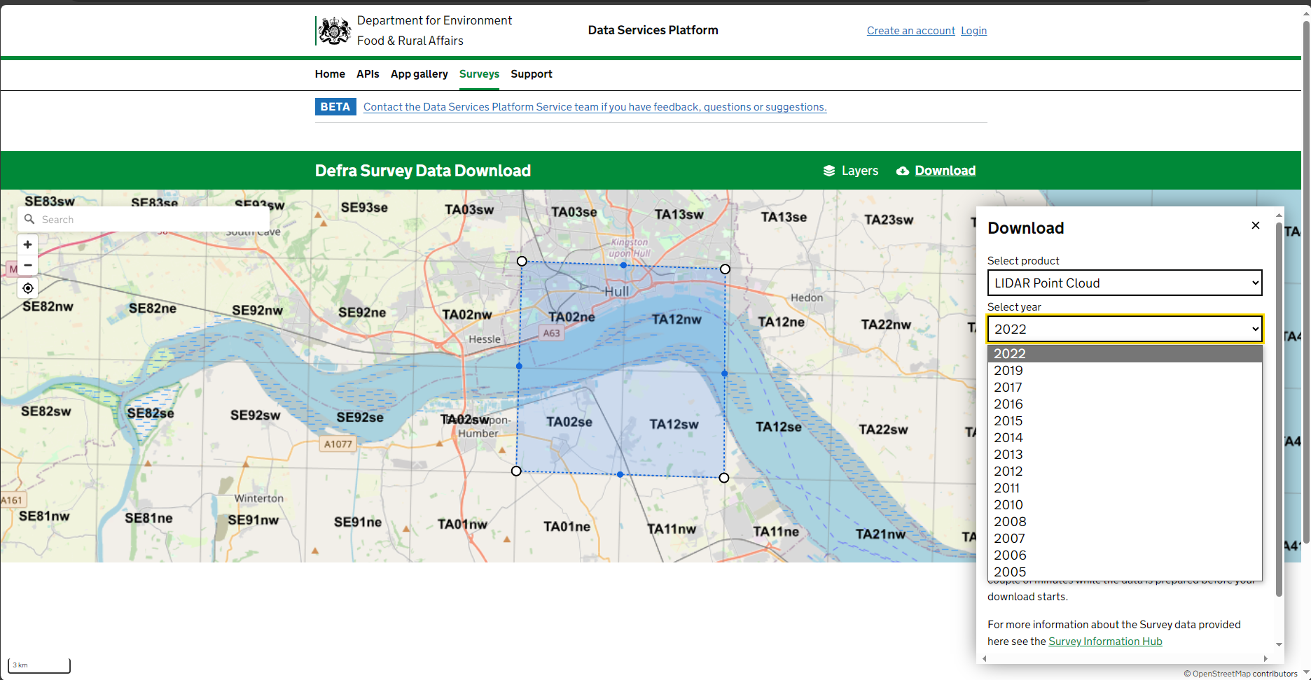
Data
Possible Link for LiDAR
Defra Data Services Platform
Format data : .LAZ

Slide 3
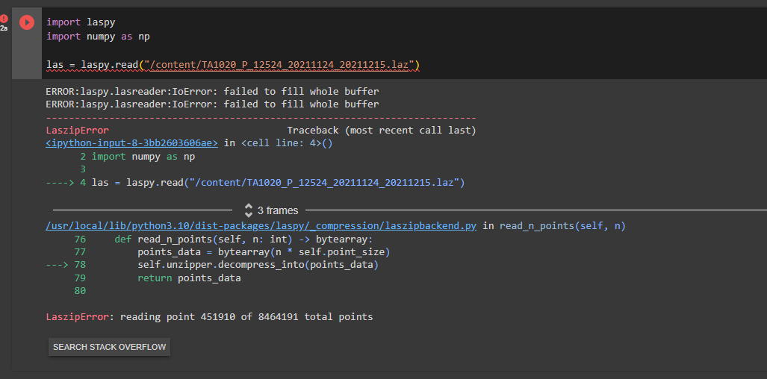
Data

Slide 4
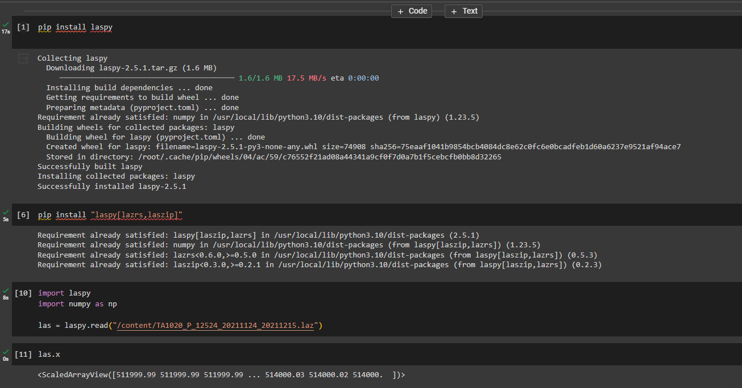

Slide 5
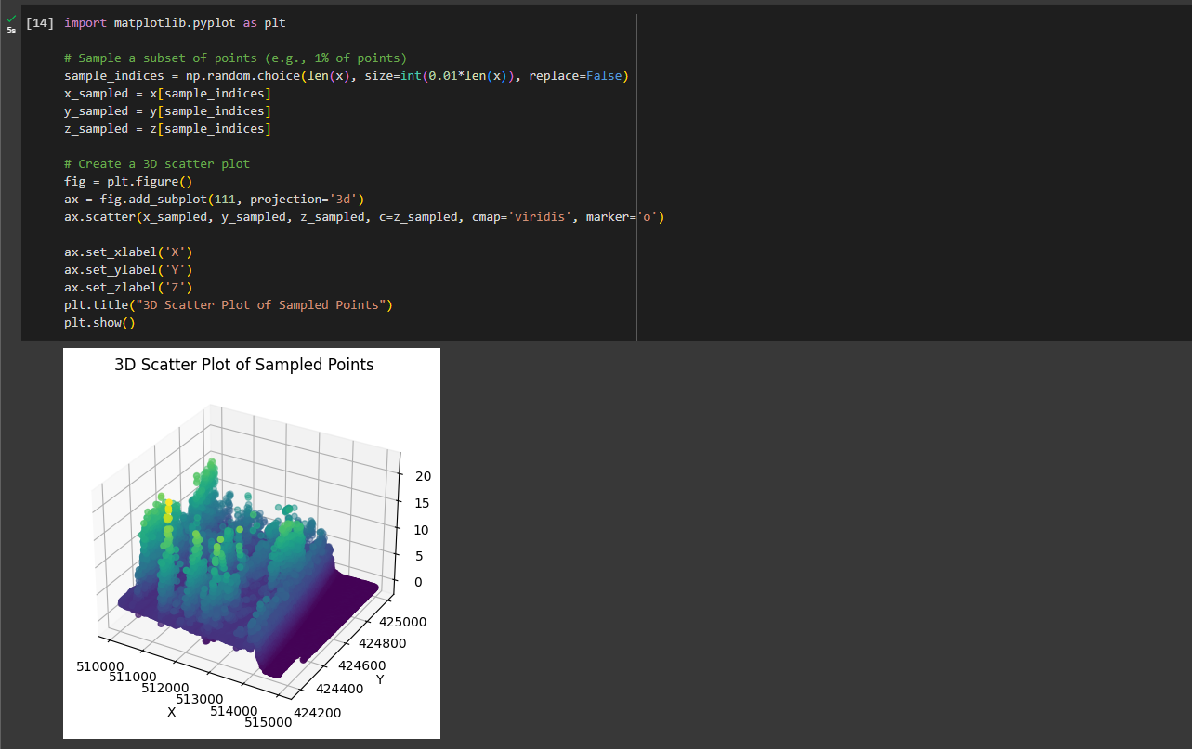

Slide 6
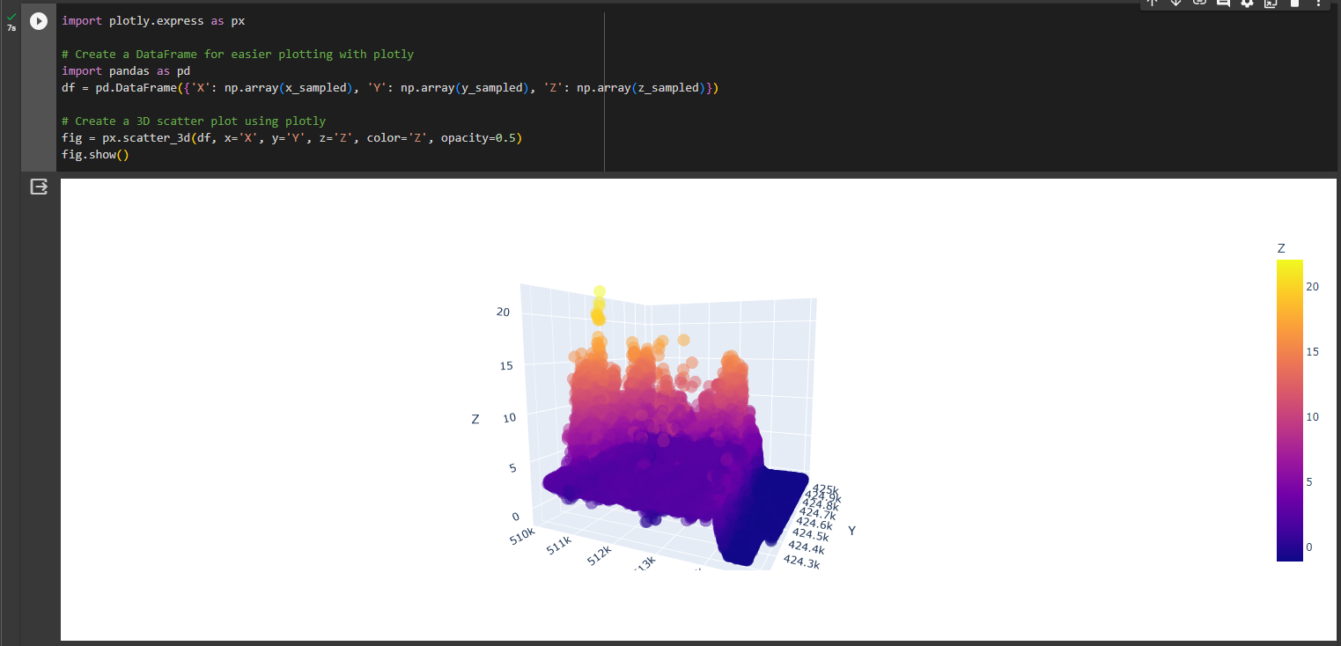

Slide 7
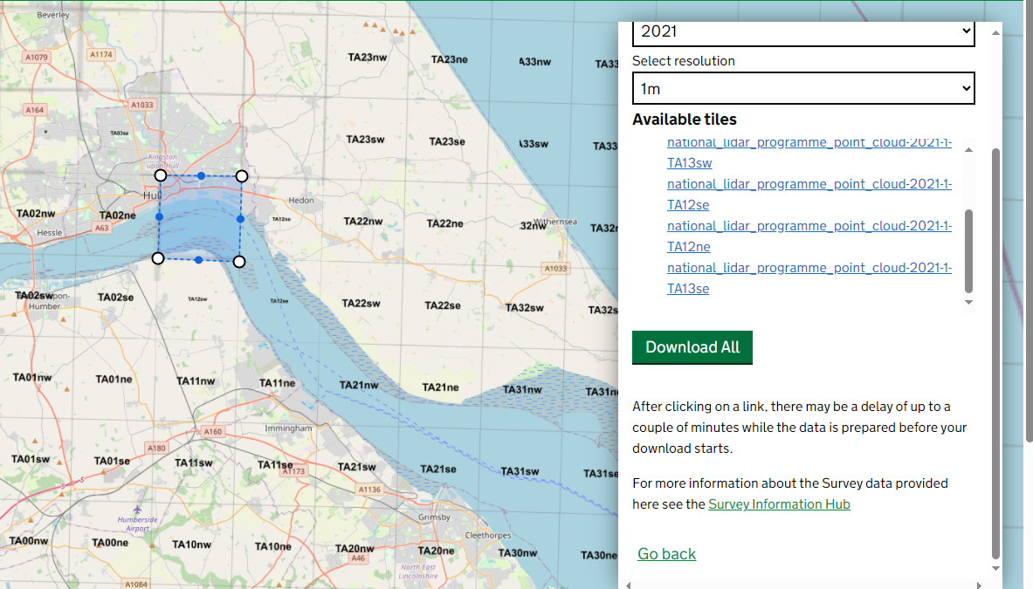

Slide 8
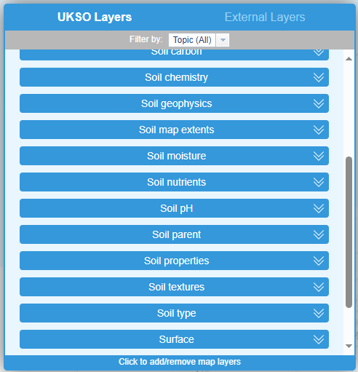
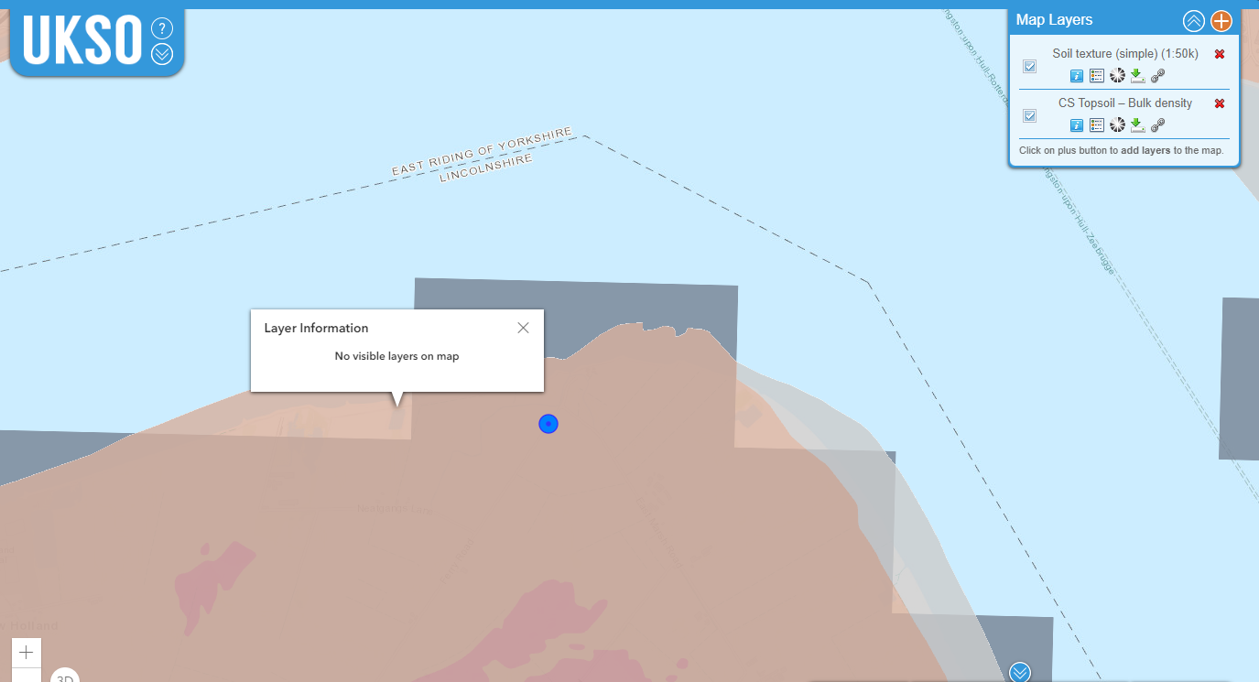
Soil Data
UK Soil Observatory (bgs.ac.uk)

Slide 9
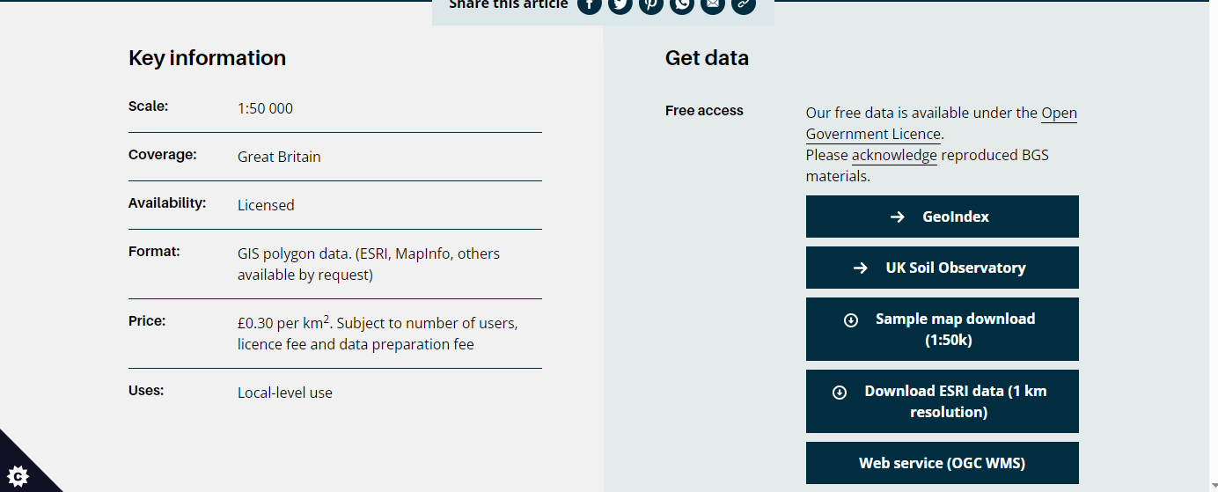
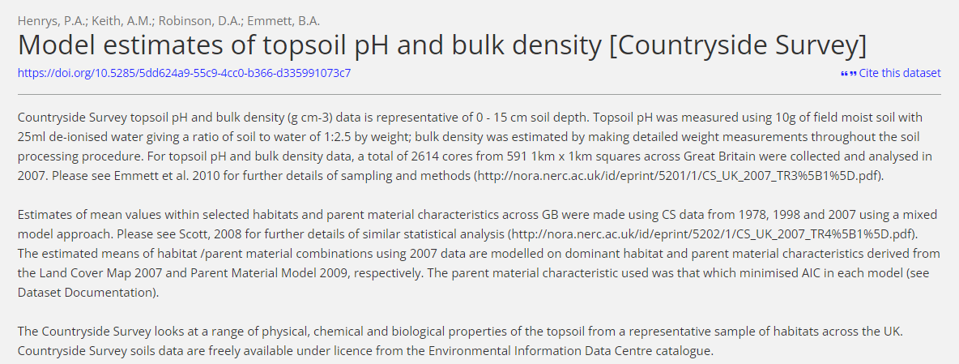
Task : Geopandas

Slide 10
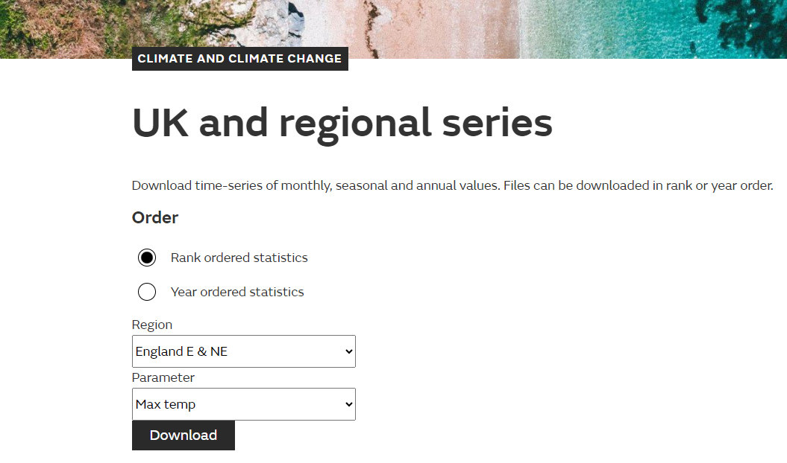

Climate Data
UK and regional series - Met Office

Slide 11
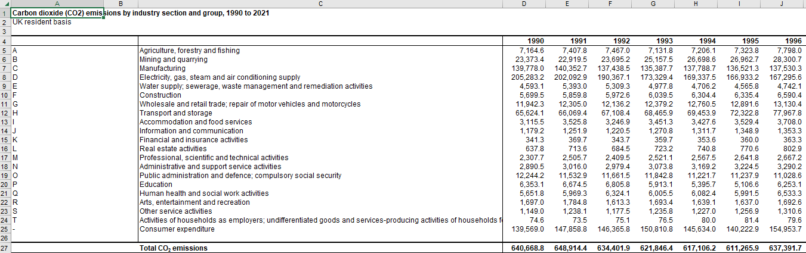
Climate Data
Environmental accounts - Office for National Statistics (ons.gov.uk)

Slide 12
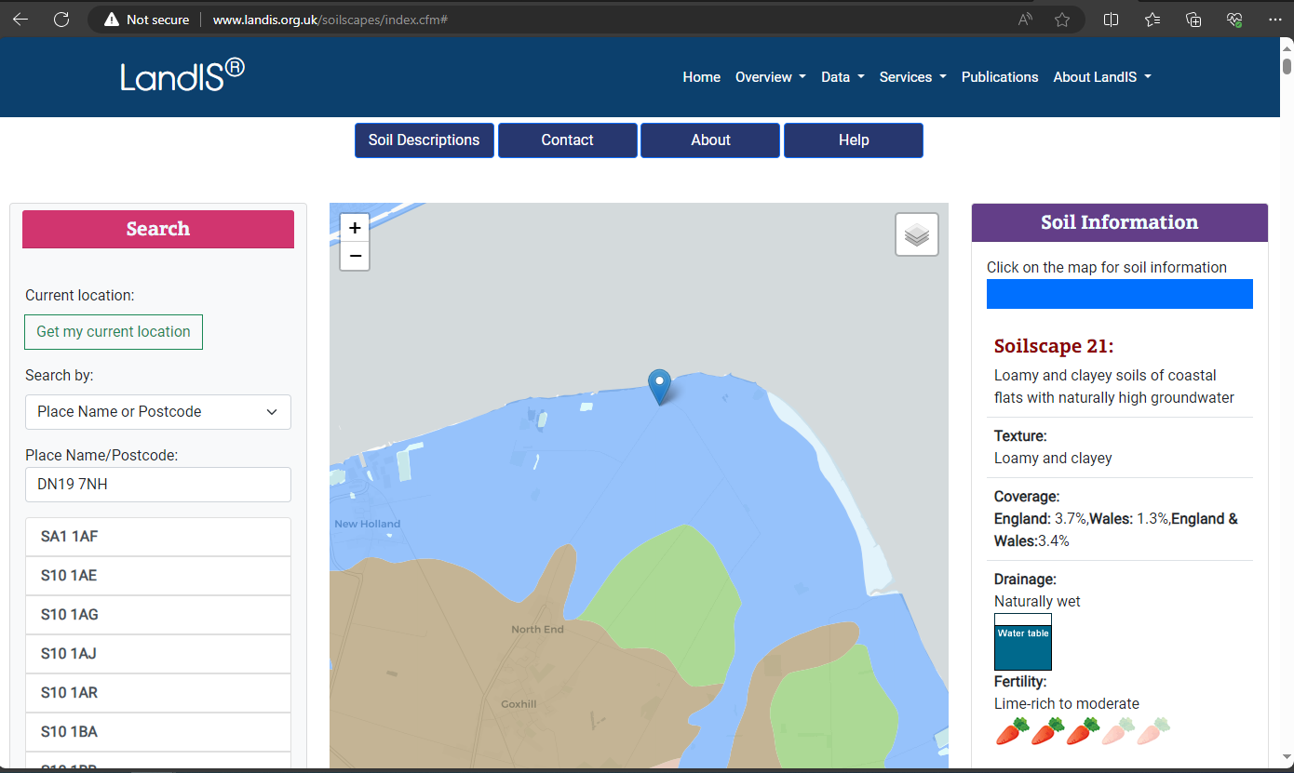
Soil Type
LandIS - Land Information System - Soilscapes soil types viewer

Slide 13
Issue
Old Data Available
Less-detailed data availability
Type of Data (maps)
Should I put chemical substances as a consideration ?

Slide 14
Reference

